Slide 1
ADW Query performance
Aug 26, 2021

Slide 2




ADW Performance Benchmakerking
Downloaded Hotel_reviews.csv which has 238.5MB size and consists of ~516K rows and 17 columns. It is mix of text e.g., ‘reviews’ and numbers
Created Hotel_reviews_516Kby51.csv which has 713.9MB size. [Hotel_reviews | Hotel_reviews | Hotel_reviews]
Created Hotel_reviews_1547Kby17.csv which has 713.9MB size. It was formed by three times stacking Hotel_reviews
Uploaded the Three above mentioned files to OBS, ADW, and DS compute environment
Read data using DS Jupyter Notebook from the above mentioned storages
Repeated the experiment 178 times and took average
Object Storage
Various data sources
Data Science
Data Science
Oracle ADW
HOTEL_REVIEWS
Illustration of Dataset shapes
TRIP_DATA
238 MB
516K x 17
713 MB
516K x 51
713 MB
1.54K x 17
1.75 GB
10.9M x 19
3.5 GB
10.9M x 38
180 MB
1M x 19
360 MB
1M x 38
16 MB
100K x 19
32 MB
100K x 38

Slide 3
Elapsed Times: Average/STD of 178 Runs for Hotel_Reviews Datasets
 |  | 238.5 MB: 514K rows by 17 cols [sec] | 713.9 MB: 1.54M rows by 17 cols [sec] | 713.9 MB: 514K rows by 51 cols [sec]
ADW | Alchemy Optimized | [7.39 1.17] | [20.01 2.06] | [15.72 1.55]
 | Alchemy Not Optimized | [39.1 20.47] | [118.64 61.43] | [51.41 22.19]
 | pd.ads.sql | [8.87 0.88] | [22.58 1.61] | [27.04 2.26]
 | PD.read_sql Optimized | [12.28 0.74] | [36.46 1.78] | [34.26 0.88]
 | PD.read_sql Not Optimized | [46.05 22.14] | [135.75 59.5 ] | [70.92 22.45]
Object Storage with ads package |  | [17.89 0.85] | [35.67 1.85] | [52.47 1.99]
Object Storage with ocifs package |  | [7.46 0.58] | [21.72 1.59] | [22.74 1.89]
Attached Storage |  | [3.03 0.03] | [8.64 0.07] | [9.45 0.11]
The numbers in the table are average time of reading data from different storage locations. The average has taken from 178 runs. The compute shape was: VM.Standard2.24

Slide 4
Elapsed Times: Average/STD of 35 Runs for Trip Datasets
 |  | 16.3 MB: 100K rows by 19 cols | 32.5 MB: 100K rows by 38 cols | 180 MB: 1MM rows by 19 cols | 360 MB: 1MM rows by 38 cols | 1.75 GB: 10.9MM rows by 19 cols | 3.5 GB: 10.9MM rows by 38 cols
ADW | Alchemy Optimized | [2.32 0.86] | [2.65 0.24] | [18.12 1.34] | [24.58 0.82] | [168.46 4.69] | [313.65 8.46]
 | Alchemy Not Optimized | [5.85 2.43] | [9.18 2.26] | [50.65 11.1 ] | [92.59 17.46] | [582.44 115.38] | [1150.58 196.39]
 | pd.ads.sql | [2.02 0.51] | [3.64 0.11] | [15.69 0.16] | [34.25 0.31] | [162.87 1.26] | [370.39 2.06]
 | PD.read_sql Optimized | [3.43 0.47] | [5.91 0.22] | [32.39 0.77] | [61.43 0.7 ] | [370.29 6.59] | [777.55 11.13]
 | PD.read_sql Not Optimized | [6.57 1.15] | [12.71 2.01] | [69.75 11.93] | [129.36 15.91] | [778.11 180.22] | [1586.95 158.51]
Object Storage [ads] |  | [2.79 0.28] | [4.65 0.24] | [8.86 0.39] | [15.53 0.73] | [77.09 2.59] | [158.75 4.9 ]
Object Storage [ocifs] |  | [0.73, 0.19] | [1.19, 0.24] | [5.72, 0.75] | [10.67, 0.63] | [64.95, 4.89] | [136.41, 5.04]
Attached Storage |  | [0.28 0. ] | [0.57 0. ] | [2.63 0.06] | [5.64 0.12] | [29.04 0.43] | [63.38 1.04]
Some Observations on elapsed times:
Dependency on query methodology such as Alchemy, Pandas, ADS, …
Query optimization has significant impact
Time and date of query: looks like ADW [the one I am using] has a shared-infrastructure causing performance variation
Size, content [may be], and shape of data has impact on performances
Experiments show that placing tables in ADW has better read-time compared to OBS if number of rows in the table are less than a few hundred thousand

Slide 5
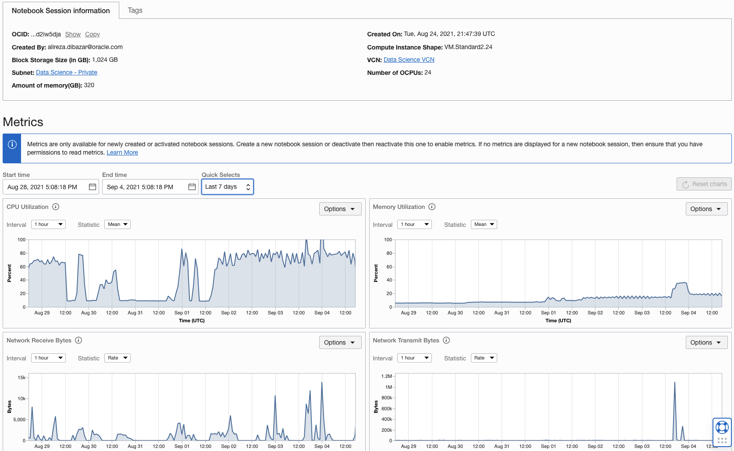

Slide 6
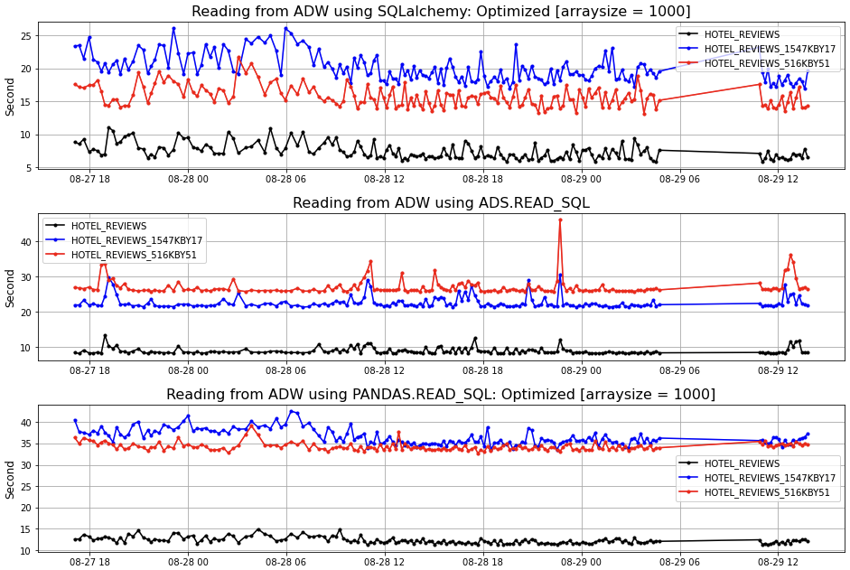
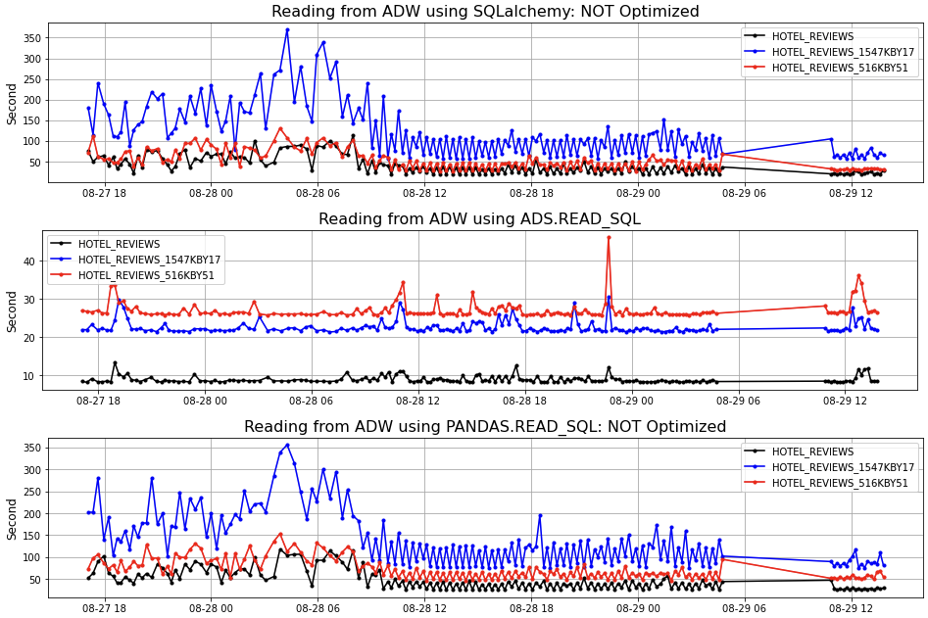
Performance Charts
Optimized Queries
Unoptimized Queries

Slide 7
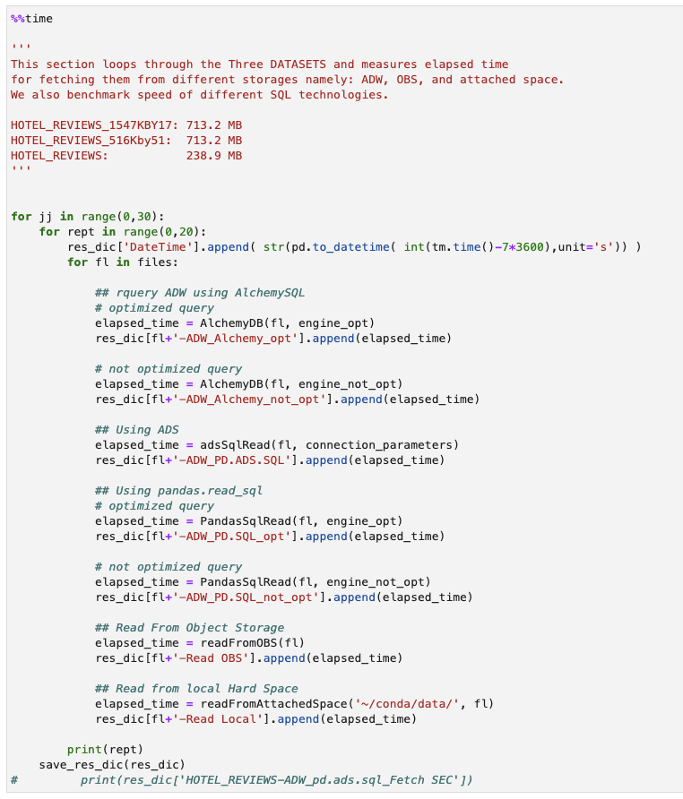
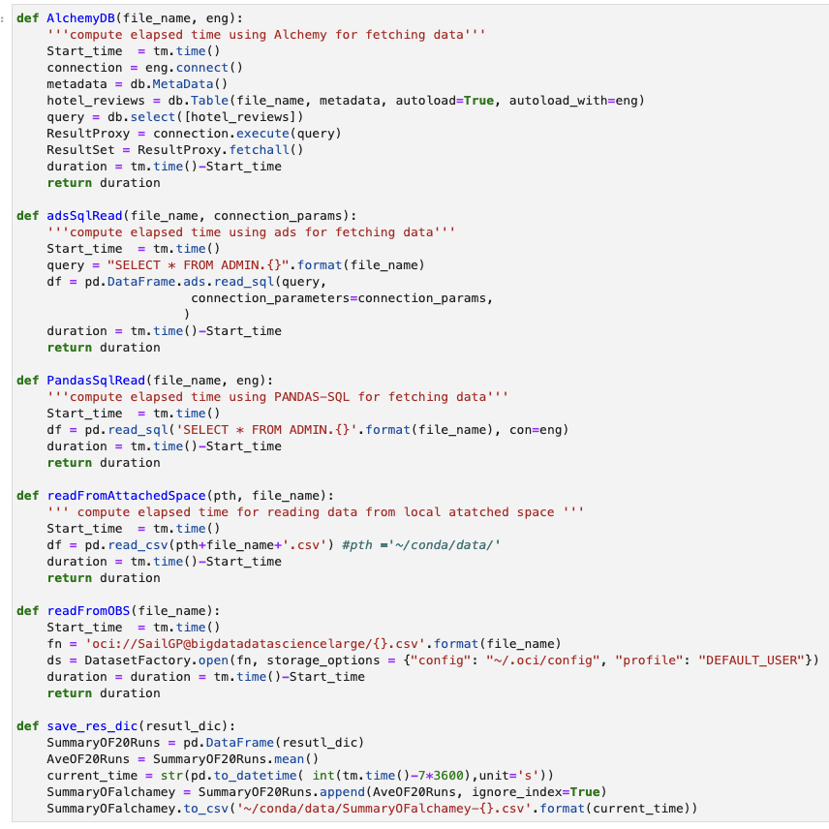
Code

Slide 8
Appendix
I deployed the Spark code [this is the one for which Nishant has created dataflow],
Connected to the Joe's data table
Trained and tested model. no issues so far.
Got R2=0.9

Slide 9
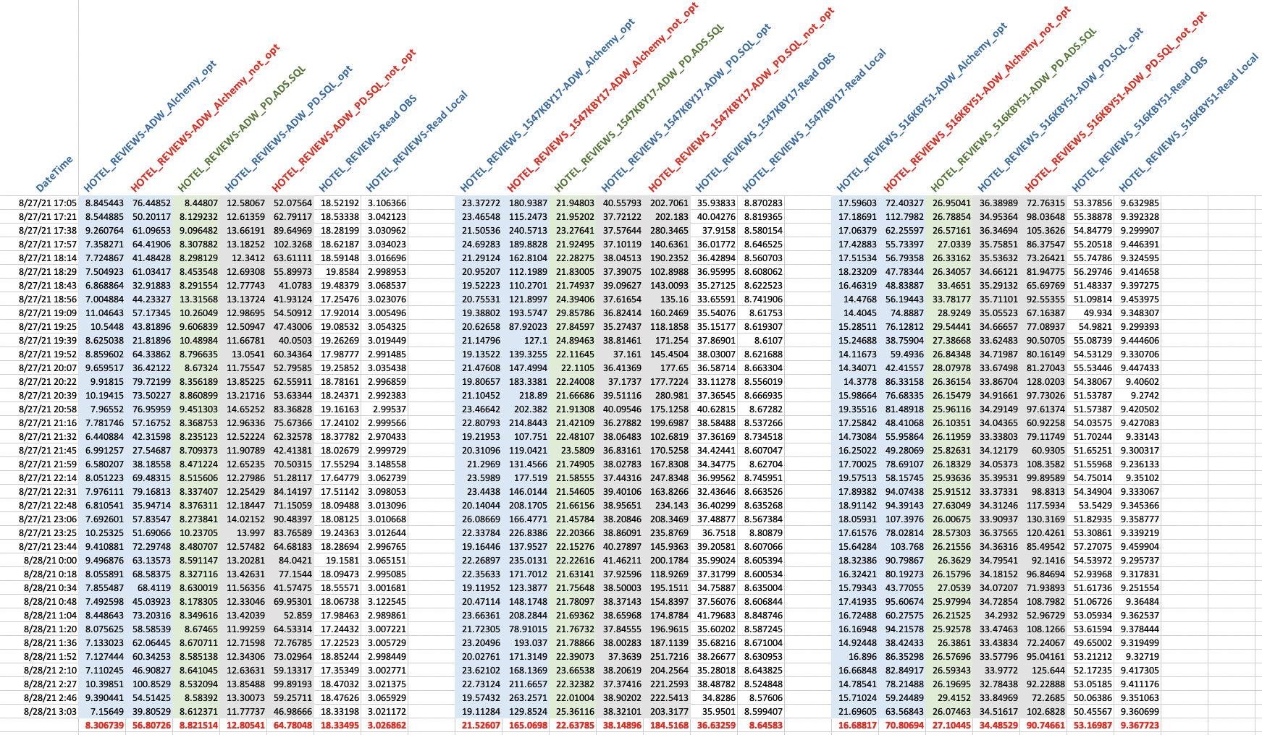
Results: With/out Optimization
238.5 MB: 516K rows and 17 cols | 713.9 MB: 1.54M rows and 17 cols | 713.9 MB: 516K rows and 51 cols

Slide 10
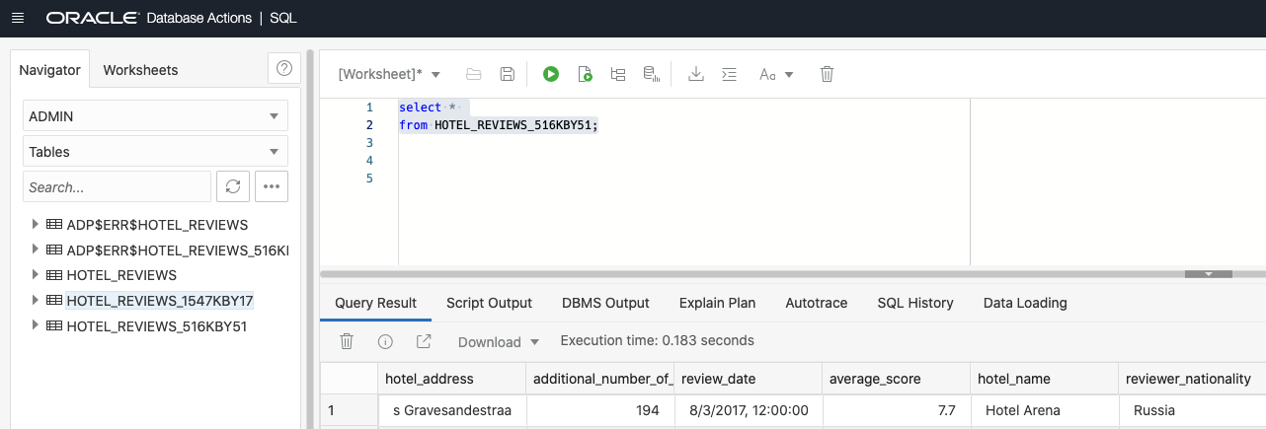
Using SQL Tool Execution Time is less than One sec
Execution Time = 0.183

